Slide 1
GREEK NODE PARTNERS
3.7.2020

Slide 2
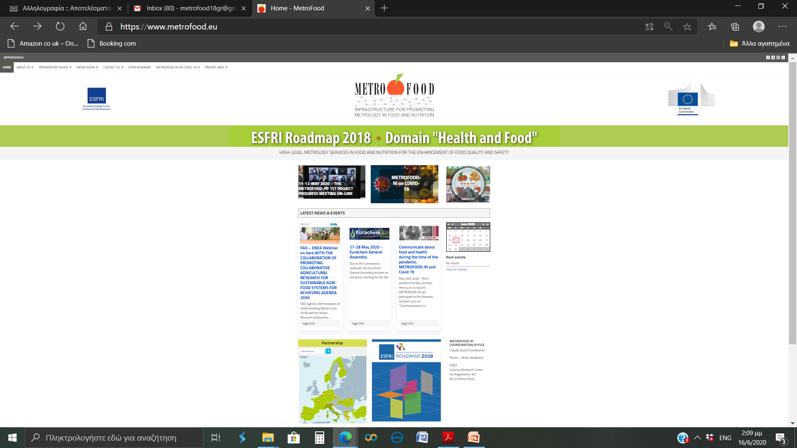
What METROFOOD-RI IS ABOUT
HIGH-LEVEL METROLOGY SERVICES IN FOOD AND NUTRITION FOR THE ENHANCEMENT OF FOOD QUALITY AND SAFETY https://www.metrofood.eu/
At National level
At EU level
At Global level
National Nodes
ERIC status
?

Slide 3
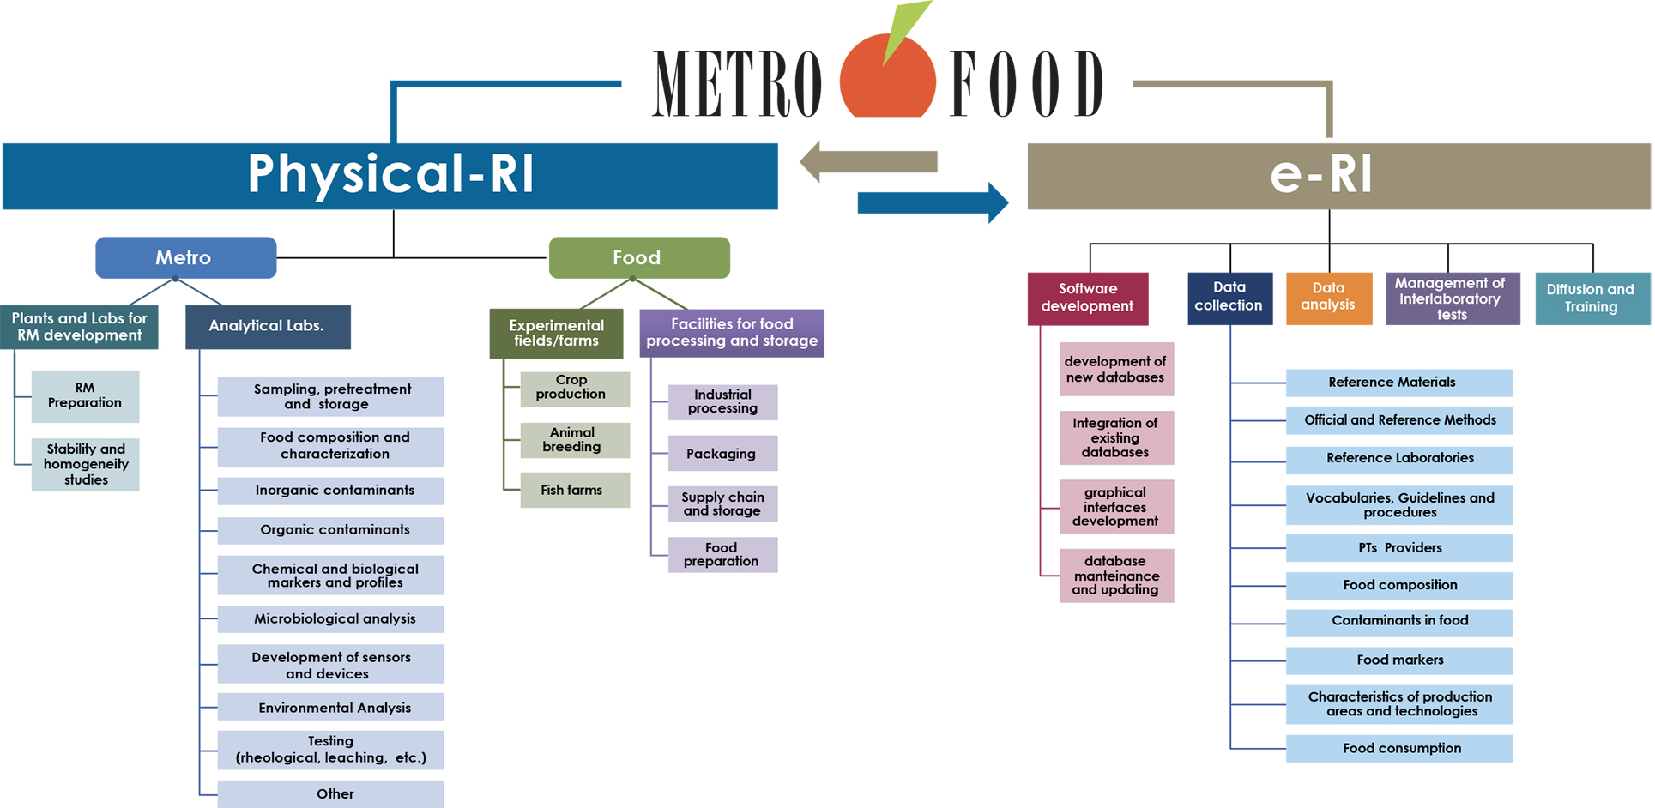
What METROFOOD-RI IS ABOUT
HIGH-LEVEL METROLOGY SERVICES IN FOOD AND NUTRITION FOR THE ENHANCEMENT OF FOOD QUALITY AND SAFETY https://www.metrofood.eu/

Slide 4
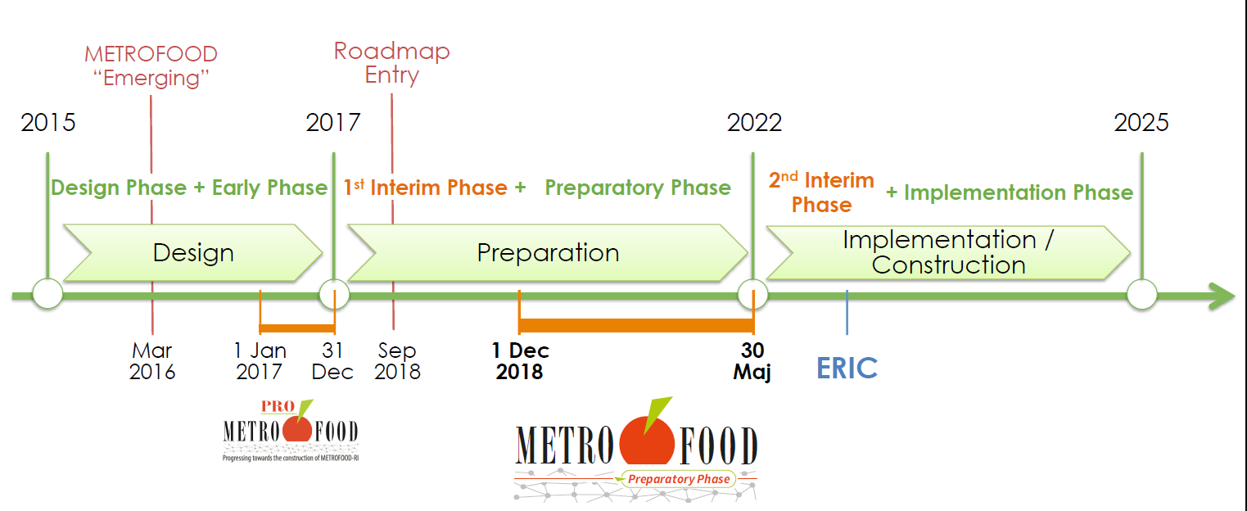


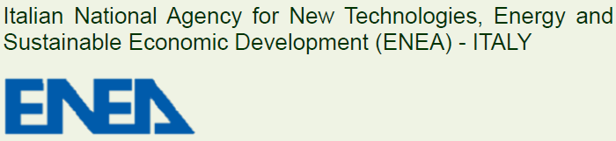
What METROFOOD-RI IS ABOUT
HIGH-LEVEL METROLOGY SERVICES IN FOOD AND NUTRITION FOR THE ENHANCEMENT OF FOOD QUALITY AND SAFETY https://www.metrofood.eu/
Giovanna Zappa
Claudia Zoani

Slide 5
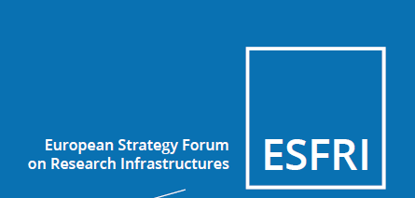
Why is METROFOOD-RI IMPORTANT
It is the only RI that has been approved in the Health and Nutrition Domain of the ESFRI 2018
Tα νέα έξι έργα ESFRI είναι τα:
DiSSCo (Distributed System of Scientific Collections),
EHRI (European Holocaust Research Infrastructure),
eLTER (Long-Term Ecosystem Research in Europe),
EU-IBISBA (European Industrial Biotechnology Innovation and Synthetic Biology Accelerator),
IFMIF-DONES (International Fusion Materials Irradiation Facility DEMO-Oriented Neutron Source) και
METROFOOD (Infrastructure for promoting Metrology in Food and Nutrition)
Συμμετοχή χωρών!
European Research Infrastructure Consortium (ERIC)
Kοινοπραξία ευρωπαϊκής ερευνητικής υποδομής (ΚΕΕΥ)
έχει νομική υπόσταση
και διέπεται από το κοινοτικό νομικό πλαίσιο

Slide 6
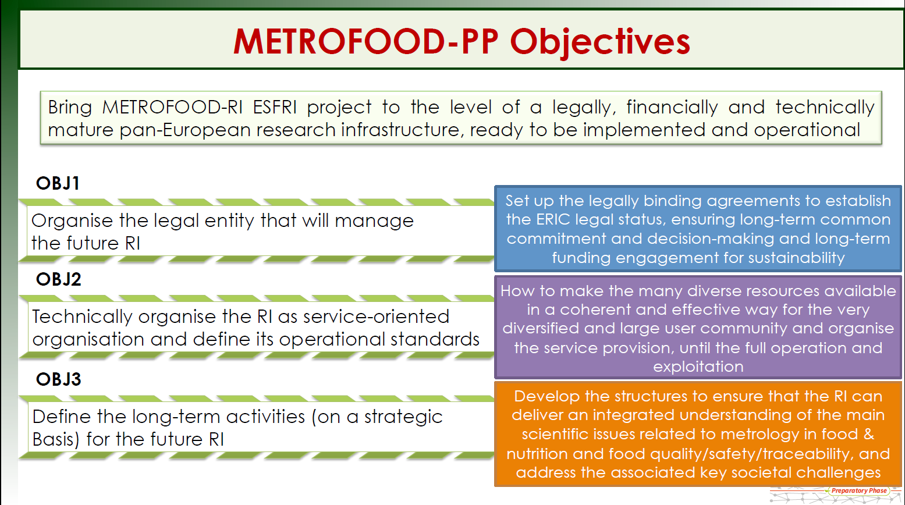
Current METROFOOD-RI phase:
Preparatory Phase (PP)

Slide 7
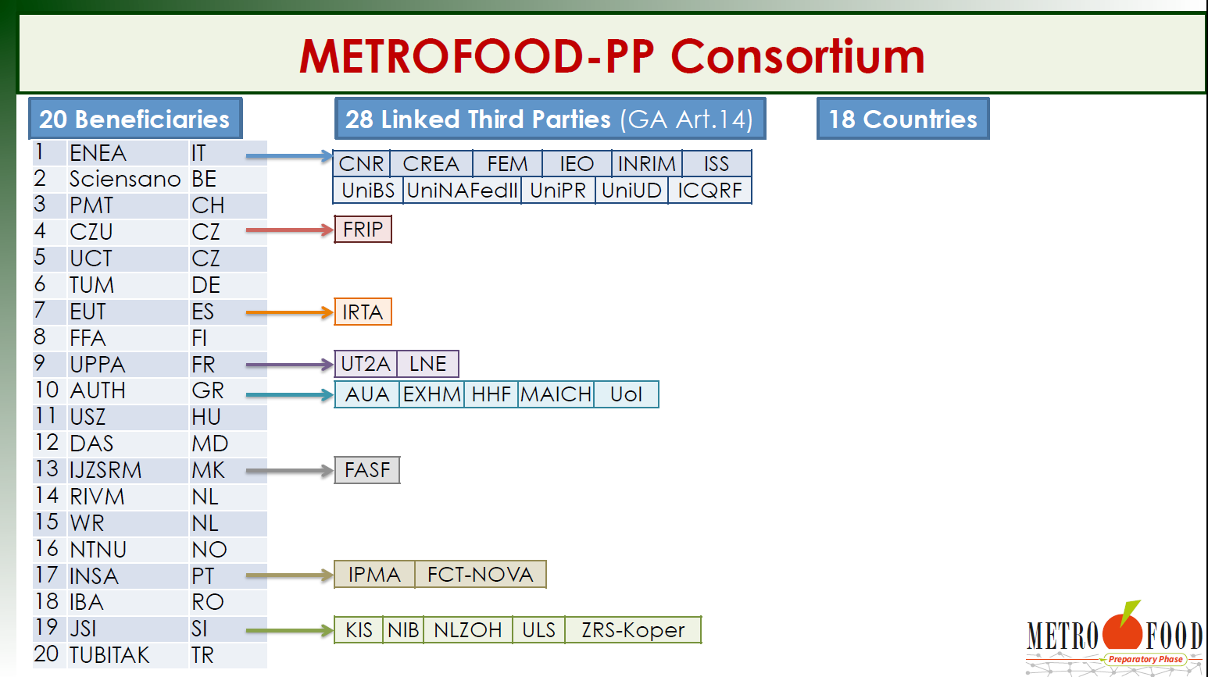
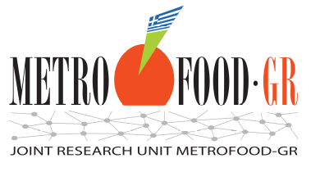

Slide 8
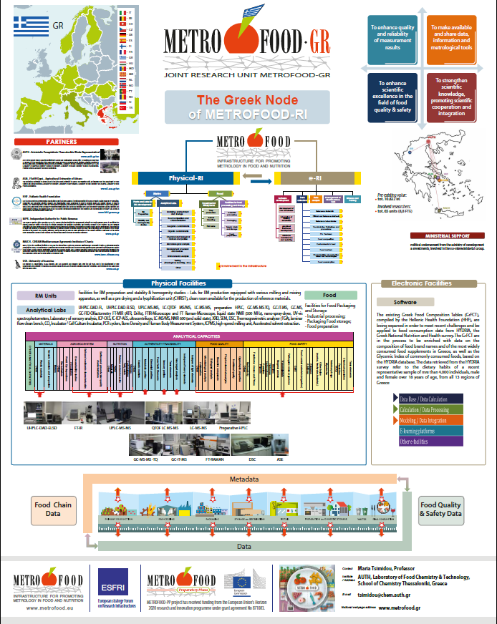

Slide 9
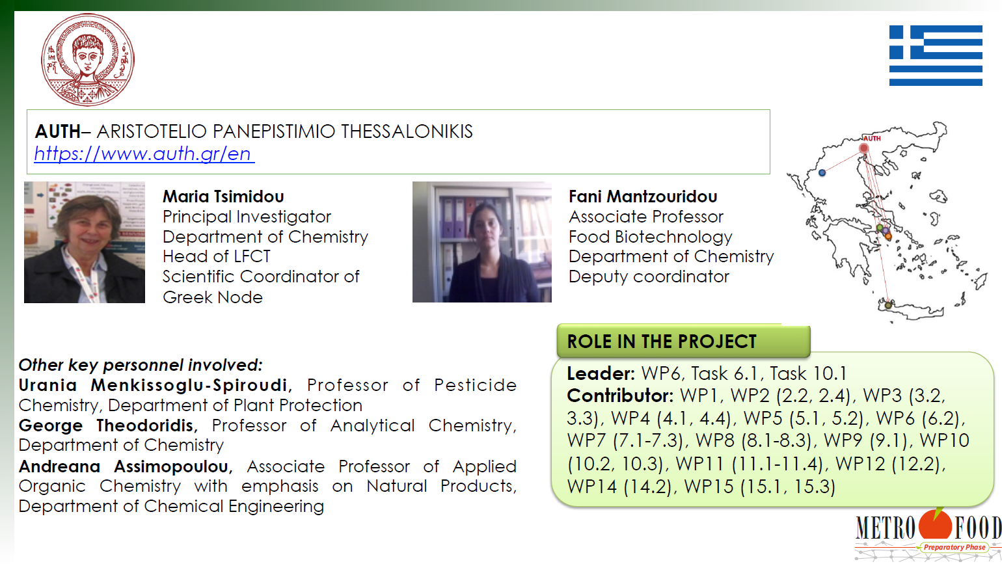

Slide 10
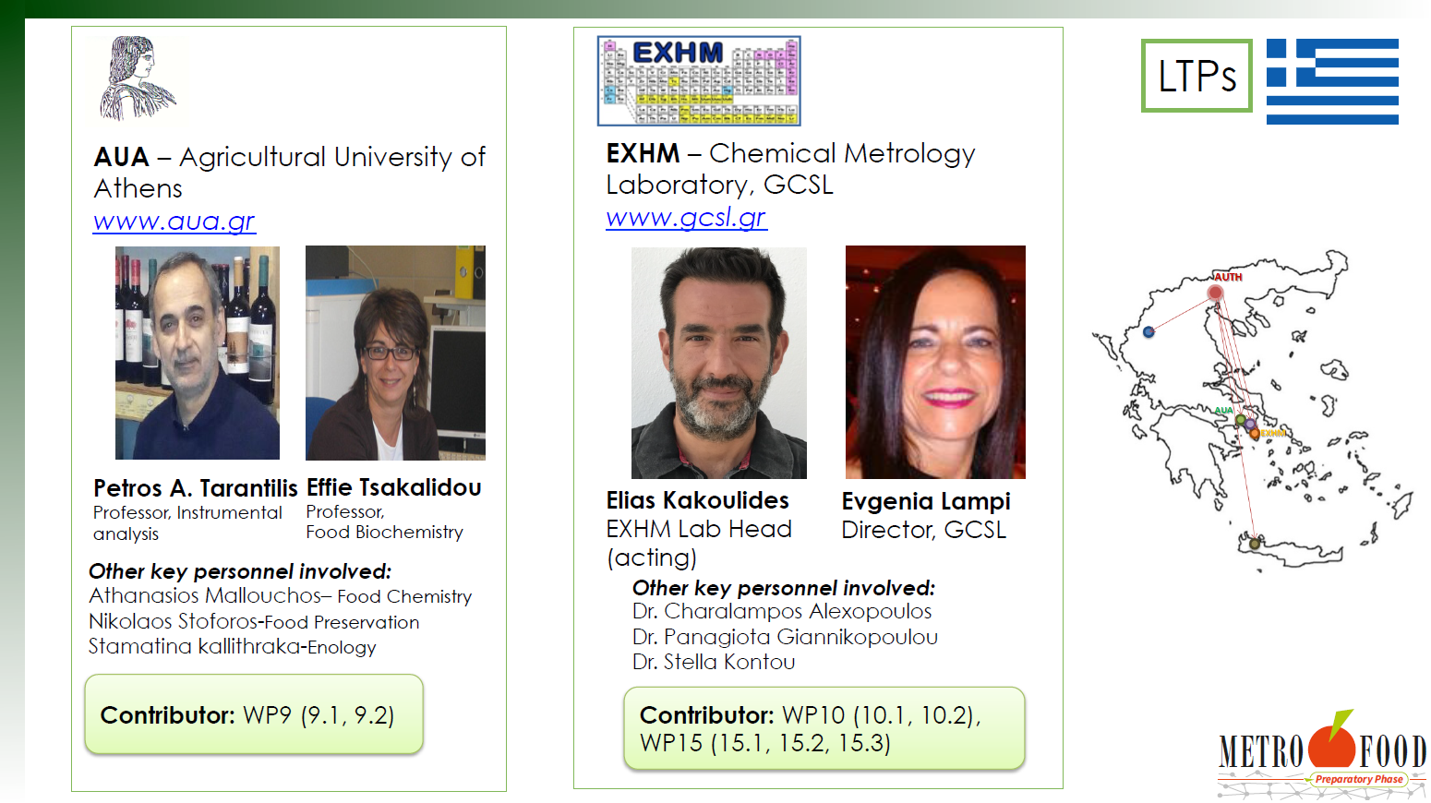

Slide 11
